Slide 1

Breast is Best
Image courtesy of breast feeding problems
The comprehensive cook book using Breastmilk
Author: Lori Wilson
Notes:
front

Slide 2
Contents
Breastmilk Soap & Breastmilk butter - Page 3
How to store Breastmilk - Page 4
Interesting facts – Page 5
4-6 Month Old Recipes – Pages 6-11
6-8 Month Old Recipes - Pages 12 - 17
9-12 Month Old Recipes – Pages18- 24
12 Month Onwards Recipes – Pages 25-30
Adults Only Recipes – Pages 31-35
References pages 36
Notes:
back

Slide 3
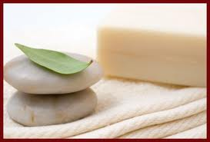
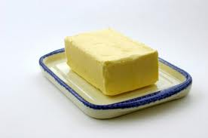
RECIPE
Breast milk Soap
Ingredience
2 cups vegetable oil (such as olive or coconut)
1/4 cup water
1/4 cup lye (solid NaOH)
1 cup breastmilk
Method
Heat oil to 115°F. In a glass measuring cup, add lye to water. When the solution reaches 115°F, add to oil. Stir until the mix is silky; then add milk. Colour will change; it is normal. Stir until you get instant pudding consistency, approximately 60 to 45 minutes. Pour in moulds. You can use almost anything, like silicone muffin tin or cookies tray. Avoid using metallic trays. Let sit 2 or 3 days, until you can unmould soaps easily. You have to let your soap “cure” 4 to 5 weeks, until it becomes neutral. You should get approximately 12 soaps.(Thorn Apple Ridge Soaps)
RECIPE
Breast milk Butter
Ingredience
Breastmilk
Method
Add breast milk to a clean jam jar. Screw lid on tight and shake vigorously until you have butter. (The Green Parent,2012)
Image courtesy of Farex
Notes:
Front
http://www.thegreenparent.co.uk/articles/read/recipes-for-breastmilk/
thornappleridgesoaps.com

Slide 4
How To Store breastmilk
Expressed breast milk can be stored for later use. It is recommended that the milk is stored in hard-sided containers with airtight seals
Place of storage | Temperature |  | Maximum storage time
In a room | 25°C | 77°F | Six to eight hours
Insulated thermal bag with ice packs |  |  | Up to 24 hours
In a refrigerator | 4°C | 39°F | Up to five days
Freezer compartment inside a refrigerator | -15°C | 5°F | Two weeks
A combined refrigerator and freezer with separate doors | -18°C | 0°F | Three to six months
Chest or upright manual defrost deep freezer | -20°C | -4°F | Six to twelve months
Breastfeeding basics,2011
Notes:
www.breastfeedingbasics.com

Slide 5

Interesting Facts
Introducing Solid Foods to Baby
•Wait until your baby hits the six-month mark before introducing solid food.
•Your infant may be ready to try solids if she can sit up and shows an interest in what you're eating.
•Wait three days after introducing each new food before trying another.
•Talk to your doctor before starting foods that could trigger a reaction, such as milk and eggs.
•When introducing textures, experiment with ripe fruit and soft, cooked vegetables, pasta and meats–all sliced into pieces no larger than 1/4- to 1/2-inch.
Introducing New Foods
•It can take 12 to 16 tries before a toddler really takes to a new food.
•Keep portions of new foods small.
•If your child takes a bite, celebrate!
•Add a squirt of lemon, grated cheese or a dressing for dipping to make new foods more fun.
•Studies show waiting to expose infants to allergenic foods may not reduce their risk of developing an allergy.
•Starting solids earlier than six months could be harmful to your baby, whose body may not be ready to break down the food.
•When it comes to fruit and vegetables, there’s no right or wrong way to start.
•Gagging is a natural part of learning how to eat and most babies gag at some point as they try more textured foods.
When Can You Add Spice to Baby Food?
•Most babies can handle herbs and some spices by eight months of age.
•Spices are transferred through breast milk and you may find your baby can tolerate some better than others.
•Herbs are often easier than spices for babies to digest.
•It’s important not to add salt to baby food because a baby’s kidneys can’t process it.
(Just The Facts Baby)
Notes:
http://www.justthefactsbaby.com/baby/feeding-and-nutrition/page=3

Slide 6
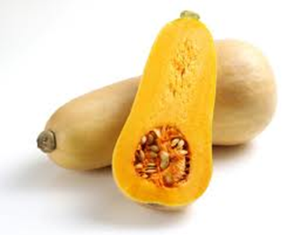



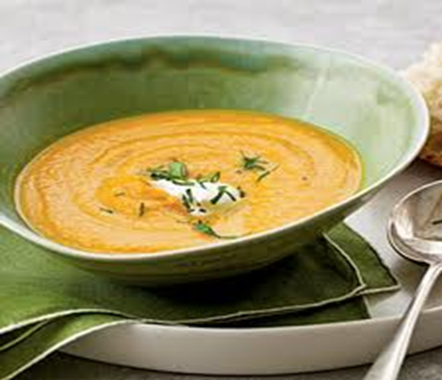
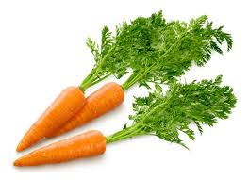
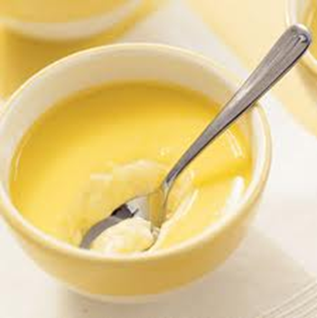
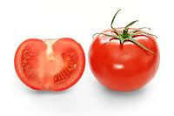
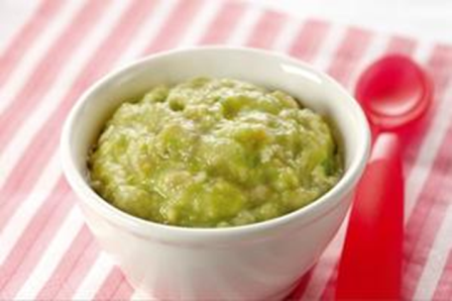
4- 6 Month Recipes
Notes:
Front
whatisee.squarespace.com

Slide 7


Baby's first taste of solid food should be a single ingredient, age appropriate food. A few wonderful choices for first foods for babies are creamy avocados, bananas and sweet potatoes.(Momtastic)
RECIPE
suitable 4mths onwards
Creamy Mash
Ingredience
½ ripe Avocado
1-2 Tbs. Breastmilk
Method
Halve 1 avocado
Place in bowl mash with fork
Add 1-2 Tbs of breast milk
Mash until mixture is of desired smooth consistency (Farex,2012)
Image courtesy of Mom Tastic
Variations to this recipe include:
Cooked sweet potato
Banana
Combination of avocado & banana
Cooked apples
Cooked pear
Mango
Image courtesy of Farex
Notes:
back
http://wholesomebabyfood.momtastic.com/babyfirstfoods.htm
http://farex.com.au/Recipes/Avocado-Banana-Mash

Slide 8


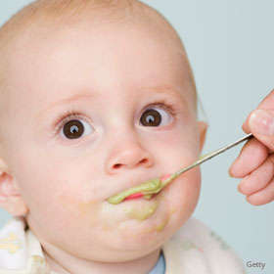

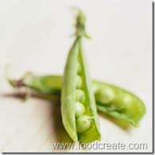
Important:
Follow the 4-day Rule while introducing new foods to your baby - means give him a new food, then wait for 4 days to introduce any other new ingredient, and watch for allergies or signs of discomfort to know if this suits your baby's body or not.
(Just The Facts Baby)
RECIPE
suitable 4mths onwards
Peas Puree
Ingredience
½ cup frozen peas
1-2 Tbs. Breastmilk
Mint
Method
Cook peas as per instructions
Place food processor
Add 1-2 Tbs of breast milk
Add mint for enhanced flavour
Blend until mixture is of desired smooth consistency.(Parents Connect)
Variations to this recipe include:
Use nutmeg for flavour
Use parsley instead of mint
Photo courtesy of parents connect
Notes:
Front
www.parentsconnect.com
www.foodcreate.com

Slide 9


The current recommendation - from medical authorities such as, World Health Organization is to wait until 6 months of age before introducing solids. This is because breast milk or formula usually meet baby's nutritional needs for the first 6 months of life. However, some paediatricians recommend that babies start solids at 4 months of age.
RECIPE
suitable 4mths onwards
Sweet Potato & Carrot Soup
Ingredience
1 Carrot
1 Sweet potato
1 Tomato
½ cup Breastmilk
1 tsp. nutmeg
Method
Peel and boil all the vegetables until cooked
Place breast milk, vegetables and nutmeg into food processor and blend
Strain mixture to remove tomato seeds (Homemade baby Food,2010)
Image courtesy of wallaby childcare
Hints for this recipe include:
Freeze leftover mixture in ice cube trays , then pop out and reheat in microwave as needed.
Image courtesy of my recipes
Notes:
Back
http://www.homemade-baby-food-recipes.com/introducing-solids-at-4-to-6-months.html
wallabychildcare.com.au
myrecipes.com
http://funnfud.blogspot.com.au/2010/06/homemade-baby-food-recipes-infants-4.html

Slide 10

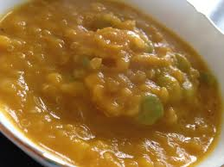
We all know about the great benefits of breast milk for mum and baby and even the environment, but are there other uses for breast milk?
Sore throats and mouth sores
Cradle cap
Ear infections
Chicken pox
Make-up remover
Cuts, scratches, scrapes and burns/sunburns
Breastmilk contains immunologic agents and other compounds that take action against viruses and parasites. Breast milk is sterile, anti-bacterial and can even help heal wounds and can help people heal faster after organ transplants and other surgeries.
RECIPE
suitable 4mths onwards
Butternut Pumpkin & Oatmeal
Ingredience
½ Butternut pumpkin
1 cup oatmeal
½ cup Breastmilk
Method
Peel and boil the pumpkin until cooked ,drain and add oatmeal and breast milk
Cook on simmer until oatmeal has absorbed all the moisture
Blend in food processor until smooth consistency
Image courtesy of my recipes
Notes:
Front
lisaprojectvegan.blogspot.com
http://www.breastfeeding-problems.com/using-breast-milk.html

Slide 11


RECIPE
suitable 4mths onwards
Breast milk Custard
Ingredience
1 egg yolk
½ teaspoon sugar
1 level tablespoon maize cornflour
1 cup (250mls) breastmilk
Method
In a small microwave bowl , whisk egg yolk, sugar, cornflour and ¼ cup of the milk
Microwave the remaining ¾ cup of milk on full power for 1 minute.
Whisk hot milk into yolk mixture
Microwave for 1 minute, whisk, then microwave 30 seconds. Whisk again. Let cool for about 3 minutes
RECIPE
suitable 4mths onwards
Mumsicle
Ingredience
Breastmilk
Method
Express milk and put into ice cube trays or place milk in egg cup and dummy on top.
Place in freezer and allow to freeze , give to baby on warm days
Image courtesy of Mom Tastic
Notes:
Back
http://busymommymedia.com/2009/09/breastmilk-popsicle-momsicle/
http://www.nutriciababy.co.nz/main/recipes/baby_custard_d.html

Slide 12
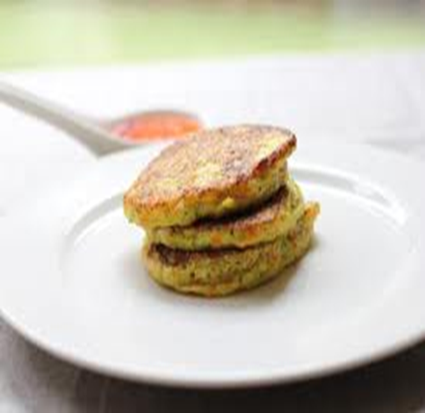
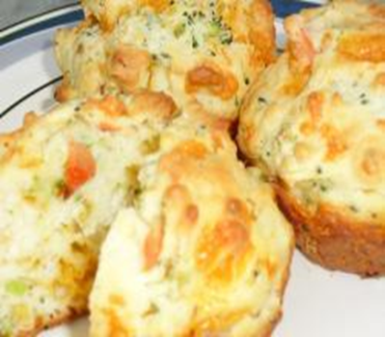


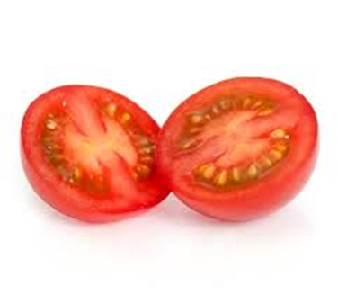
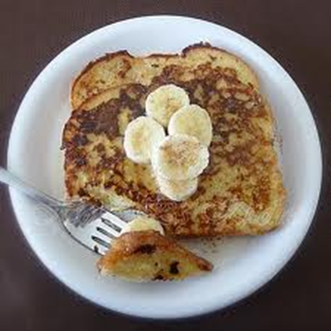
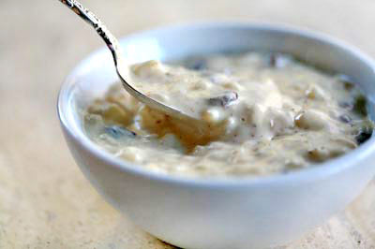
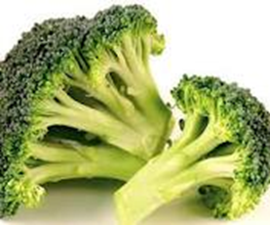
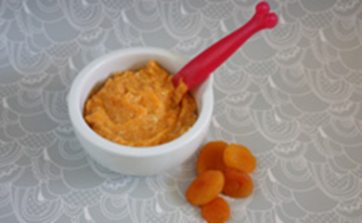
6- 8 Month Recipes
Notes:
Front

Slide 13

Around the age of six months, an infant's need for energy and nutrients starts to exceed what is provided by breast milk and complementary foods are necessary to meet those needs. At about six months of age, an infant is also developmentally ready for other foods
RECIPE
suitable 6mths onwards
Rice Pudding
Ingredience
1/2 cup brown Rice
2 cups water
1/4 cup apples sliced into slivers
1/4 cup sultanas
2 tsp. cinnamon
1/2 tsp. ginger
1/8 cup Breastmilk
Method
Combine all of the above ingredients in a medium saucepan.
Cook over medium-low heat for 30 minutes or until rice is soft, fragrant and a bit soupy
Stir 1/8 cup breastmilk into the rice, keep on heat for 10 more minutes. Keep a close watch to ensure that the consistency remains soupy but not pasty.
Stir frequently to stop sticking to the pot and add more breast milk if necessary.
Serve warm then transfer remaining portion to the fridge.
Image courtesy of my recipes
Notes:
Back
http://wholesomebabyfood.momtastic.com/stage2-baby-food-recipes.htm
simplyrecipes.com

Slide 14

RECIPE
suitable 6mths onwards
Apricot Chicken
Ingredience
1 small chicken thigh
1 cup chopped sweet potato
1 cup water
2 fresh apricots or 3-4 dried apricots
1 tbsp. olive oil
1/8 cup Breastmilk
Method
Dice the chicken in smallish pieces. If using fresh apricots, wash and half them and remove stones. Cut into quarters. Dried apricots don't need any preparation.
Heat oil in a saucepan and add chicken. Cook for a few minutes until sealed and browned.
Add the water, sweet potato and apricots.
Bring to the boil and then simmer on reduced heat for around 15-20 minutes or until apricots and potatoes are soft. Drain water
Pour the contents in a food processor and add breastmilk and puree until smooth.(wholesome baby food)
Image courtesy of Mom Tastic
Notes:
Fronthttp://wholesomebabyfood.momtastic.com/stage2-baby-food-recipes.htm
simplyrecipes.com
http://www.kidspot.com.au/best-recipes/Baby+3/Apricot-chicken-recipe+3892.htm

Slide 15

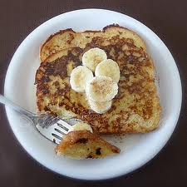
RECIPE
suitable 7mths onwards
French Banana Toast
Ingredience
1 slice wholemeal bread
½ banana mashed
½ cup Breastmilk
1 egg
Method
Mash banana spread well over one side of the bread
Beat egg and milk together soak bread in egg and milk mixture until the majority has been absorbed.
In a fry pan over medium heat add a little butter and place wet bread in until golden brown, turn and fry other side.
Serve when cooled and cut into fingers for little hands.( Grumpys)
Notes:
Back
grumpyshoneybunch.com
fatburningfurnace.com

Slide 16



RECIPE
suitable 7mths onwards
Vegetable fritters
Ingredience
½ can corn – blended in food processor
½ a Zucchini grated
½ a Carrot grated
½ a small Sweet potato
1 cup plain flour
1 cup breastmilk
1 egg
Method
Combine milk, flour and egg and stir until a smooth consistency.
Grate zucchini, sweet potato and carrot into mixture and add corn kernels.
In a frypan over medium heat add a large tablespoon of mixture , fry until golden brown turn and do on the opposite side. (TASTE,2012)
Did You Know ?
Sweet potatoes are root vegetables and some people call them "yams", although they are not true yams at all. In fact, they are not even distantly related to yams, which are bigger, with scaly skin and pale pink flesh
Image courtesy of TASTE

Slide 17



RECIPE
suitable 6mths onwards
Cheese and Broccoli Muffins
Ingredience
6 cooked broccoli florets, chopped
6 grape/cherry tomatoes, chopped
1 cup grated Cheddar cheese
2 cups self rising flour
3/4 cup breastmilk
3 tbsp. olive oil
1 egg, beaten
Method
Pre-heat the oven to 180 deg C.
In a bowl, mix together the flour, cheese and chopped broccoli.
Add the chopped tomatoes, milk, oil and egg and blend thoroughly.
Grease a 12 hole muffin tin and spoon in the batter.
Bake for 25 to 35 mins until golden. (Homemade baby Food,2010)
Please note that these muffins will be fairly dense and moist.
Image courtesy of Home made baby food
Exclusive breastfeeding for six months has many benefits for the infant and the mother. Chief among these is protection against gastro-intestinal infections which is observed not only in developing but also in industrialized countries. Early initiation of breastfeeding, within one hour of birth, protects the newborn from acquiring infections and reduces newborn mortality (WHO,2012)
Notes:
Back
http://www.homemade-baby-food-recipes.com/baby-led-weaning-recipes.html#ixzz1ritPgvuw
http://www.who.int/mediacentre/factsheets/fs342/en/index.html

Slide 18
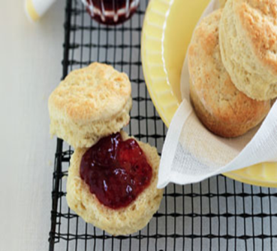
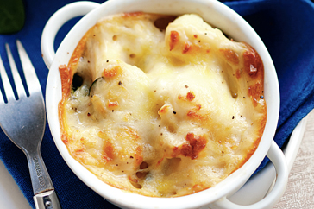
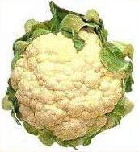


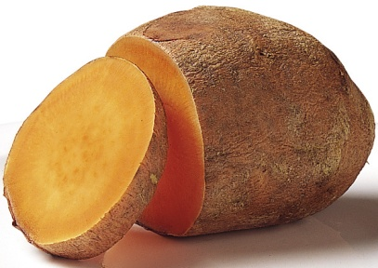
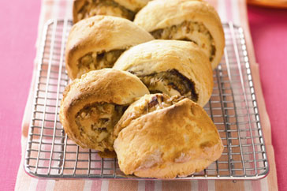
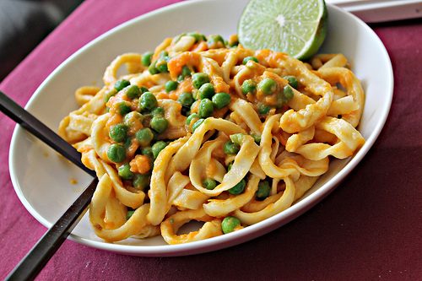
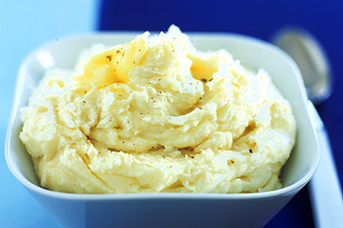
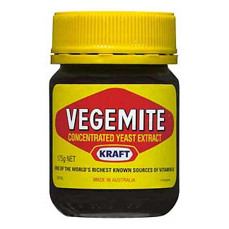
9- 12 Month Recipes
Notes:
front

Slide 19


RECIPE
suitable 9mths onwards
Classic Scones
Ingredience
4 cups self-raising flour
2 tablespoons icing sugar mixture
pinch of salt
3/4 cup Breastmilk
3/4 cup thickened cream
1 egg, lightly beaten
Extra milk, for brushing
Strawberry jam and double cream, to serve
Method
Preheat oven to 220°C/200°C fan-forced. Line a baking tray with baking paper. Position oven rack in the top half of oven.
Sift flour, sugar and salt into a bowl. Make a well in centre. Combine milk, cream and egg in a jug. Pour milk mixture into well. Using a flat-bladed knife, gently stir until dough just comes together. Turn out onto a lightly floured surface. Knead gently until just smooth.
Press dough into a 2cm-thick round. Using a 6cm round cutter, cut out scones. Press leftover dough together. Repeat to make 12 scones.
Place scones, just touching, on prepared tray. Brush with milk. Bake for 13 to 15 minutes or until golden. Serve warm with jam and cream.(TASTE,2012)
VARIATIONS – Add a little pumpkin or sultanas to the mix
Breast milk is also an important source of energy and nutrients in children 6 to 23 months of age. It can provide one half or more of a child's energy needs between 6 and 12 months of age, and one third of energy needs between 12 and 24 months. Breast milk is also a critical source of energy and nutrients during illness and reduces mortality among children who are malnourished.(WHO,2012)
Image courtesy of TASTE
Notes:
Back
http://www.taste.com.au/recipes/24542/classic+scones
http://www.who.int/mediacentre/factsheets/fs342/en/index.html

Slide 20
RECIPE
suitable 9mths onwards
Vegemite & cheese scroll
Ingredience
2 cups self-raising flour
30g butter, chilled, chopped
3/4 cup breastmilk
1 tablespoon Vegemite
3/4 cup grated reduced-fat tasty cheese
Breast milk, to glaze
Method
Preheat oven to 220°C/200°C fan-forced. Line a baking tray with baking paper. Sift flour into a bowl. Using fingertips, rub butter into flour until mixture resembles breadcrumbs. Make a well in the centre. Add milk. Using a flat-bladed knife, stir until mixture forms a soft dough, adding more milk if necessary. Turn out onto a lightly floured surface. Knead gently until smooth (don't over-knead).
Roll out to a 30cm x 20cm rectangle. Spread Vegemite over dough, leaving a 1cm strip along 1 long side. Sprinkle cheese over Vegemite. Roll up firmly. Transfer to prepared tray, seam-side down.
Using scissors, cut into top of dough at 3cm intervals without cutting all the way through. Pull slices to the left and right. Brush with milk. Bake for 20 to 25 minutes or until golden. Serve. (TASTE,2012)
Image courtesy of TASTE

Slide 21

RECIPE
suitable 9mths onwards
Sweet potato and plantain soup
Ingredience
1 sweet potato, peeled and sliced
1 green plantain, peeled and sliced
little olive oil
1 small onion, chopped very finely
1 clove of garlic, crushed
2 cups homemade chicken stock
1 bay leaf
1/2 cup breastmilk
Method
Sauté the garlic and onions in the olive oil until tender, then add the plantain and cook until browned all over.
Pour in the chicken stock, then add the bay leaf and bring to the boil.
Add the sweet potatoes.
Reduce the heat and simmer until the vegetables are tender (this should take around 20-25 mins).
Cool briefly, then blend in a food processor until nice and creamy (take the bay leaf out first!).
Return the mixture to the pan, then stir in the milk.
Simmer gently for a further 10 mins, then serve! (Homemade baby Food,2010)
A Plantain is a type of Banana that is best used in cooking not for eating
Notes:
Back
http://www.homemade-baby-food-recipes.com/sweet-potato-baby-food-recipes.html#ixzz1riw8jGCo

Slide 22

RECIPE
suitable 9mths onwards
Sweet potato pasta sauce
Ingredience
little olive oil
1/2 small onion, chopped
1 clove of garlic, crushed
1 small sweet potato, peeled and cut into cubes
1/2 cup breastmilk
Method
Sauté the onion and garlic in the oil over a low heat until tender.
Add the sweet potato and enough water to just cover it, then bring to a boil.
Reduce the heat, then simmer very gently for 20 mins.
Cool, then place in a food processor with the milk and blend well.
Serve over cooked pasta ravioli and large spirals are best for babies (Homemade baby Food,2010)
Did You Know
Researchers have discovered that 6-month-old babies can distinguish between individual humans or individual monkeys. But by 9 months, while babies could still tell the difference between human faces, they can’t tell one monkey from another
Image courtesy of Home made baby food
Notes:
Front
www.homemade-baby-food-recipes.com/sweet-potato-baby-food-recipes.html#ixzz1rixfogre

Slide 23
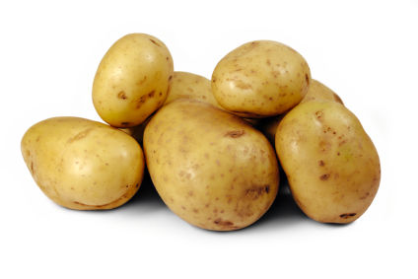
RECIPE
suitable 9mths onwards
Classic Mashed Potato
Ingredience
800g Sebago or Coliban potatoes
40g butter, chopped
1/3 cup hot breastmilk
extra butter, to serve
Method
Peel potatoes and cut into large chunks. Cook in a large saucepan of boiling salted water for 20 minutes or until very tender but not falling apart.
Drain potatoes well. Return to saucepan over low heat. Shake pan gently until any remaining water evaporates. Using a potato masher, roughly mash potatoes.
Add butter and hot milk to potatoes. Beat with a wooden spoon until fluffy. Season with salt and pepper. Serve topped with extra butter and salt and pepper(TASTE,2012)
Image courtesy of TASTE
Notes:
Back
http://www.taste.com.au/recipes/7752/classic+mashed+potato

Slide 24
RECIPE
suitable 9mths onwards
Chicken and spinach cauliflower cheese pots
Ingredience
1 small (800g) cauliflower, cut into florets
2 teaspoons olive oil
500g diced chicken breast fillet
40g butter
1/4 cup plain flour
1 cup salt-reduced chicken stock
375ml Breastmilk
80g baby spinach
1/3 cup grated tasty cheese
Method
Preheat oven to 200°C/180°C fan-forced. Cook cauliflower in a saucepan of boiling water for 5 minutes or until just tender. Drain.
Heat oil in a large saucepan over medium-high heat. Add half the chicken. Cook, stirring, for 5 minutes or until browned. Transfer to a bowl. Cover to keep warm. Repeat with remaining chicken.
Add butter to pan. Cook for 1 minute or until melted and bubbling. Add flour. Cook, stirring, for 1 minute or until bubbling. Gradually add stock, stirring until smooth. Bring to the boil. Reduce heat to low. Add milk. Simmer for 3 to 5 minutes or until thickened. Remove from heat. Stir in cauliflower, spinach and 2 tablespoons tasty cheese. Season with salt and pepper.
Spoon mixture into four 2 cup-capacity ovenproof dishes. Sprinkle with remaining cheese. Season with salt and pepper. Bake for 20 minutes or until golden. Serve (TASTE,2012)
Image courtesy of TASTE

Slide 25


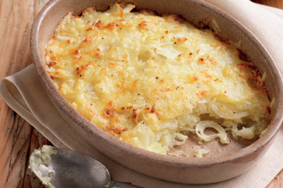

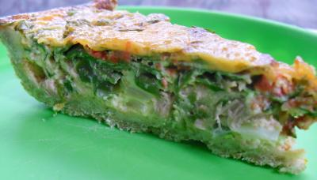
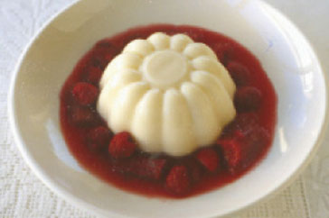
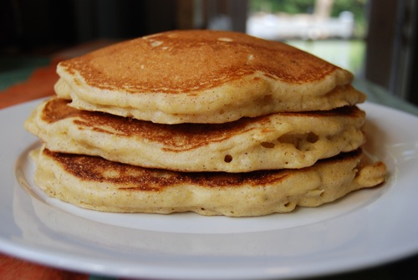
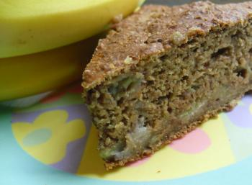
12 Month onwards Recipes
Notes:
Back

Slide 26
RECIPE
suitable 12mths onwards
Babies 1st Birthday Cake
Ingredience
1 cup) old fashioned rolled oats
1 1/4 cups whole wheat flour
1 cup all purpose flour
1 tsp. baking soda
2 tsp. baking powder
2 1/2 tsp. cinnamon
good pinch of salt
3 medium ripe bananas, peeled and mashed
1/2 cup unsalted butter, melted
½ cup Breastmilk
1/2 cup blueberries, chopped (use fresh, or frozen berries thawed and drained)
4 eggs, beaten well
3/4 cup frozen unsweetened apple juice concentrate, thawed*
Method
Preheat the oven to 350 deg F (175 deg C).
Put the first seven ingredients into a large bowl and mix them together.
Add all the rest of the ingredients and stir well until thoroughly combined.
Grease a 9 inch cake tin and pour in the mixture.
Bake for around 50 mins to one hour, until a sharp knife inserted into the centre comes out clean.
Cool in the tin for 20 mins, then turn out on a wire rack to cool completely(Homemade baby Food,2010)
Image courtesy of Home made baby food
Notes:
Front
http://www.homemade-baby-food-recipes.com/healthy-first-birthday-cake-recipes.html#ixzz1rj6Dwdwa

Slide 27
RECIPE
suitable 12mths onwards
Sweet Potato and Apple Pancakes
Ingredience
1 cup whole wheat flour
1/2 cup all purpose flour
3 heaped tbsp. rolled oats
about 2/3 cup wheat germ
2 tsp. baking powder
1/2 tsp. nutmeg
1/2 tsp. cinnamon
2 large beaten eggs
2 cups breastmilk
1/2 cup mashed, cooked sweet potato
1 apple, cored and chopped into bite sized pieces little oil
Method
Lightly steam the chopped apple or simmer it in a very little water until tender.
Mix the all purpose flour, whole wheat flour, oats, wheat germ, baking powder and spices together in a bowl.
Place the sweet potato in a separate bowl and slowly stir in the milk. Add the eggs and mix well.
Pour the wet ingredients into the dry and stir until everything is just moist, then stir in the cooked apple.
Heat a little oil in a frying pan and spoon in the mixture to form individual pancakes. Remember - our recipe produces a fairly thick mixture... if you like yours to be runnier, then thin with a little more milk.
Cook for a few minutes on each side until golden, then cool and serve. (Homemade baby Food,2010)
Leftover sweet potato and apple pancakes may be frozen for up to one month
Notes:
Back
www.homemade-baby-food-recipes.com/sweet-potato-and-apple-pancakes.html#ixzz1rjBWtXsJ

Slide 28

RECIPE
suitable 12mths onwards
Tuna and Spinach Quiche
Ingredience
1 1/2 cups whole wheat flour
3/8 cup unsalted butter
1 to 2 tbsp. water
2 tbsp. finely chopped red onion
large handful of fresh spinach, finely chopped
1 small red pepper, roasted
1 can tuna, drained
3 eggs
3/4 cup Breastmilk
1/2 cup grated Cheddar cheese
Method
Preheat the oven to 375 deg F (180 deg C).
Rub the butter into the flour between your fingertips, until the mixture resembles fine bread crumbs.
Stir in enough of the water to bring the mixture together into a ball.
Either roll out the ball of pastry or simply press it into the bottom and sides of a shallow, greased oven proof dish (we use a circular 7″ dish).
Sprinkle the pastry with the red onion, then cover the onion with the tuna.
Top the tuna with the chopped spinach.
Puree the roasted red pepper.
Beat the eggs into the milk, then stir in the red pepper puree (this gives a rich flavour, wonderful colour AND adds extra nutrients!).
Pour this mixture over the spinach and tuna.
Sprinkle the grated cheese over the top and place in the oven.
Cook for 30 to 40 minutes until set (you should be able to tilt the dish from side to side with the egg mixture remaining firm).
Cool for at least 20 minutes before serving – this allows the quiche to set even more and makes it easier for baby to pick up.
Store in the fridge for up to 48 hours or in the freezer for up to one month. (Homemade baby Food,2010)
Image courtesy of Home made baby food
Notes:
Front

Slide 29

Did You Know?
Adults who were breastfed as babies often have lower blood pressure and lower cholesterol, as well as lower rates of overweight, obesity and type-2 diabetes. Breastfeeding also contributes to the health and well-being of mothers; it reduces the risk of ovarian and breast cancer and helps space pregnancies -- exclusive breastfeeding of babies under six months has a hormonal effect which often induces a lack of menstruation. This is a natural (though not fail-safe) method of birth control known as the Lactation Amenorrhoea Method
RECIPE
suitable 12mths onwards
Milk Jelly
Ingredience
2 1/4 cups Breastmilk
1 cup thin cream
1/2 cup caster sugar
2 tsp. vanilla extract
8 tsp. powdered gelatine
Method
Place milk, cream, sugar and vanilla in a saucepan over low heat, stirring until the sugar dissolves. Remove from heat.
Place 1/4 cup water in a heatproof bowl and sprinkle gelatine over top. Sit bowl in a saucepan of gently simmering water, and stir over low? Heat until gelatine dissolves and liquid is clear.
Add to milk mixture, then pour into a 5-cup (1.25L) mould. When cooled, refrigerate overnight. (TASTE,2012)
Serve with rhubarb & raspberry compote.
Image courtesy of TASTE
Notes:
back
http://www.taste.com.au/recipes/5865/milk+jellies

Slide 30
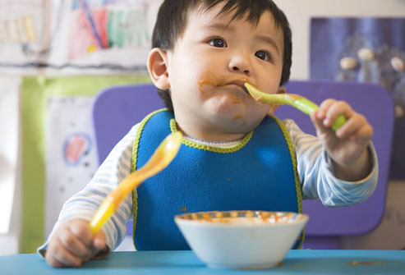
RECIPE
suitable 12mths onwards
Potato Bake
Ingredience
700g desiree potatoes, peeled, thinly sliced
1 small brown onion, thinly sliced
1/2 cup grated tasty cheese
1/4 cup Breastmilk
1/4 cup pure cream
2 garlic cloves, crushed
Pinch ground nutmeg
Method
Preheat oven to 180°C/160°C fan-forced. Lightly grease a 6 cup-capacity baking dish.
Make milk mixture: Combine milk, cream and garlic in a jug. Season with salt and pepper. Add nutmeg to milk mixture.
Layer one-quarter potato over base of prepared dish. Top with one-third onion. Repeat layers, finishing with potato.
Pour milk mixture over potato mixture. Sprinkle with cheese. Bake for 45 to 50 minutes or until potato is tender and cheese golden. Stand for 5 minutes. Serve. (TASTE,2012)
VARIATION – Add sweet potato to the bake
Picky eating is a common developmental behaviour and is about control, not taste.
Start introducing new tastes and textures early to help prevent bad habits from forming.
Use words like "special treat" to describe broccoli and carrots, not chocolate and cookies.
Image courtesy of TASTE
Notes:
front
http://www.taste.com.au/recipes/24973/potato+gratin

Slide 31


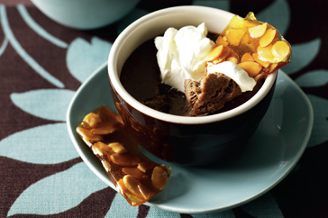
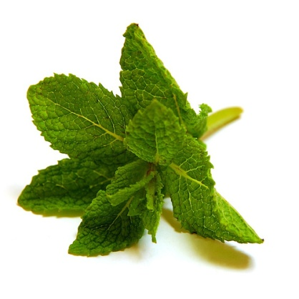


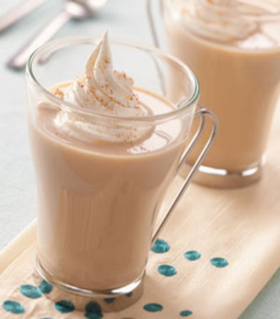
Adults Only Recipes
Notes:
Back
elle.com

Slide 32
RECIPE
suitable for adults only
Cappuccino custard pots with almond praline
Ingredience
2/3 cup thickened cream
2/3 cup Breastmilk
1/4 cup freshly brewed espresso
1/4 cup brown sugar
200g milk chocolate, coarsely chopped
2 eggs
4 egg yolks
Double cream, to serve
Almond praline
1/2 cup (50g) flaked almonds
3/4 cup (155g) caster sugar
Method
Preheat oven to 150°C. Combine the cream, milk, coffee, sugar and chocolate in a medium saucepan over low heat. Cook, stirring occasionally, for 5 minutes or until chocolate melts and mixture is smooth.
Use a balloon whisk to whisk eggs and yolks in a bowl. while whisking, gradually add cream mixture until well combined. Pour evenly among four 1-cup capacity ovenproof dishes. Place in a roasting pan. Pour enough boiling water into pan to come halfway up the side of dishes. Bake for 15 minutes or until custards are just set. Remove from oven; refrigerate for 2 hours.
To make the praline, scatter the almonds over an oven tray. Bake in preheated oven for 2-3 minutes or until just toasted.
Grease an oven tray. Place sugar in a medium frying pan over high heat. Cook, stirring, for 5 minutes or until the sugar dissolves and caramelises. Remove from heat. Add almonds and shake the pan to combine. Pour over the prepared tray. Set aside for 10 minutes to set. Lift off tray and coarsely break into shards. Dollop custard pots with cream and serve with praline.(TASTE,2012)
Notes:
front

Slide 33


Breast milk can be substituted in many recipes; however, unlike cow's milk, breast milk is not pasteurized or homogenized and must be used fresh, or kept frozen until needed.
RECIPE
suitable for adults only
Peach Cream
Ingredience
2 1/4 cups breastmilk
2 tablespoons sugar
1 teaspoon vanilla extract
1 can unsweetened peach slices
1 can lemon-lime carbonated beverage, chilled
Method
In a food processor combine breast milk, sugar, and vanilla.
Add the peaches, blend until smooth
Transfer to Jug
Slowly pour in carbonated beverage
Stir gently
Serve immediately.(Land of Milk & Honey,2009)
Notes:
back
http://www.landmilkhoney.com/recipanr.htm
en.amerikanki.com
hootingyard.org

Slide 34

RECIPE
suitable for adults only
Java Chill
Ingredience
2 cups breastmilk
3/4 cup brewed espresso or
double-strength coffee, preferably dark-roast
2 teaspoons granulated sugar
2 ounces dark or bittersweet chocolate, chopped
Method
The night before, fill an ice cube tray with breast milk. Freeze
solid. Chill brewed coffee in the refrigerator. Finish in two batches, so the blender won't overflow: place half the milk cubes in the container. Add half the coffee and one teaspoon of the sugar and blend until smooth. Add one ounce chopped chocolate and blend 10-30 seconds, until chocolate is well blended. Pour into tall, frosted glasses and repeat with the remaining ingredients. (Land of Milk & Honey,2009)
Notes:
front
Starbucksfs.com
http://www.landmilkhoney.com/recipanr.htm

Slide 35


RECIPE
suitable for adults only
Coffee Chai
Ingredience
4 cups breastmilk
1 tablespoon instant or freeze-dried coffee
1/4 cup brown sugar
3 cinnamon sticks
6 cardamom pods (available in spice section at most supermarkets)
1/8 teaspoon grated nutmeg
1/8 teaspoon allspice
4 cinnamon sticks (optional)
Method
Combine all ingredients in a saucepan. Simmer, stirring to dissolve
sugar and instant coffee for five minutes over low heat. Don't let the mixture boil.
Let the mixture steep off the heat for 20-30 minutes. Pour through a clean sieve or strainer. Serve either hot or cold. Use optional cinnamon sticks as stirrers. (Land of Milk & Honey,2009)
Notes:
BACK
http://www.landmilkhoney.com/recipanr.htm
tasteofhome.com

Slide 36
References
Green parent.(2012).Recipes .Retrieved 8th April, 2012 from: http://www.thegreenparent.co.uk/articles/read/recipes-for-breastmilk/
Thorn apple ridge soaps(n.d.).Breastmilk Soap recipe. Retrieved 7th April, 2012 from: www.thornappleridgesoaps.com
Momtastic.(n.d.).Wholesome baby food .Retrieved 18th April, 2012 from: http://wholesomebabyfood.momtastic.com/babyfirstfoods.htm
Farex.(2012).Recipes.Retrieved 14th April, 2012 from: http://farex.com.au/Recipes/Avocado-Banana-Mash
Breast Feeding basics(2011).How to Store Breastmilk. Retrieved 18th April, 2012 from: www.breastfeedingbasics.com
Just The Facts baby.(n.d).Feeding & nutrition just the facts. http://www.justthefactsbaby.com/baby/feeding-and-nutrition/page=3
Parents Connect.(2012).Grown up twist on kids food. Retrieved 14th April, 2012 from: www.parentsconnect.com
Food Create (2011).Home Cooking/Baking Recipes + Everything Food .Retrieved 14th April, 2012 from: www.foodcreate.com
Homemade baby food.(2012). Introducing solids at 4 to 6 months- is my baby ready?. Retrieved 18th April, 2012 from: www.homemade-baby-food-recipes.com/introducing-solids-at-4-to-6-months.html
Wallaby Childcare.(2011). Retrieved 18th April, 2012 from: Nutrition. http://wallabychildcare.com.au/recipesmyrecipes.com
Fun & food Blog.(n.d.).Homemade baby food stage 1. Retrieved 8th April, 2012 from: http://funnfud.blogspot.com.au/2010/06/homemade-baby-food-recipes-infants-4.html
Lisa project vegan.(n.d.).Vegan recipes. Retrieved 14th April, 2012 from: www.lisaprojectvegan.blogspot.com
breastfeeding-problems.com.(2012).Other uses of breast milk. Retrieved 18th April, 2012 from: http://www.breastfeeding-problems.com/using-breast-milk.html
Busy mommy media.(2009).Breastmilk Popsicle – Momsicle. Retrieved 18th April, 2012 from: http://busymommymedia.com/2009/09/breastmilk-popsicle-momsicle/
Nutrica.(2009).Baby Custard. Retrieved 14th April, 2012 from: http://www.nutriciababy.co.nz/main/recipes/baby_custard_d.htmlMomtastic.(n.d.).Stage 2 baby foods. Retrieved 18th April, 2012 from: http://wholesomebabyfood.momtastic.com/stage2-baby-food-recipes.htm
simplyrecipes.com.(2012).Recipes. Retrieved 18th April, 2012 from: www. simplyrecipes.com
Kidspot.(2012).Best recipes. Retrieved 18th April, 2012 from: http://www.kidspot.com.au/best-recipes/Baby+3/Apricot-chicken-recipe+3892.htm
Grumpys (n.d.).French Banana Toast. Retrieved 18th April, 2012 from: honeybunch.com
Homemade baby food(2010). Retrieved 18th April, 2012 from: http://www.homemade-baby-food-recipes.com/baby-led-weaning-recipes.html#ixzz1ritPgvuw
Homemade baby food(2010). Retrieved 18th April, 2012 from: http://www.homemade-baby-food-recipes.com/sweet-potato-baby-food-recipes.html#ixzz1riw8jGCo
Homemade baby food(2010). Retrieved 18th April, 2012 from: www.homemade-baby-food-recipes.com/sweet-potato-baby-food-recipes.html#ixzz1rixfogre
Homemade baby food(2010). Retrieved 18th April, 2012 from: http://www.homemade-baby-food-recipes.com/healthy-first-birthday-cake-recipes.html#ixzz1rj6Dwdwa
Homemade baby food(2010). Retrieved 18th April, 2012 from: www.homemade-baby-food-recipes.com/sweet-potato-and-apple-pancakes.html#ixzz1rjBWtXsJ
WHO.(2012).Facts about breastfeeding. Retrieved 18th April, 2012 from: http://www.who.int/mediacentre/factsheets/fs342/en/index.html
TASTE.(2012).Recipes. Retrieved 18th April, 2012 from: http://www.taste.com.au/recipes/24542/classic+scones
TASTE.(2012).Recipes. Retrieved 18th April, 2012 from: http://www.taste.com.au/recipes/7752/classic+mashed+potato
TASTE.(2012).Recipes. Retrieved 18th April, 2012 from: http://www.taste.com.au/recipes/5865/milk+jellies
TASTE.(2012).Recipes. Retrieved 18th April, 2012 from: http://www.taste.com.au/recipes/24973/potato+gratin
Land of Milk & Honey.(2009).RECIPES A LA BREAST MILK..Retrieved 18th April, 2012 from: http://www.landmilkhoney.com/recipanr.htm

Slide 37




